Slide 1
Ageing: What’s inequality got to do with it?
Centre for Ageing and Inequalities
14 February 2024
@EqualAgeingNCL
Notes:
FIXED Image / Presentation title slide.
Insert title and sub-deck as required to start your presentation.
`1234567890-=qwertyuiop[]asdfghjkl;’#\zxcvbnm,./
¬!”£$%^&*()_+QWERTYUIOP{}ASDFGHJKL:@~|ZXCVBNM<>?

Slide 2
Aims for today
Ageing: What’s inequality got to do with it?
With a view towards securing long-term funding for the Centre for Ageing and Inequalities:
Consider the ways in which inequality shapes our research on ageing
Explore how we can work together to make inequalities an even greater focus of our research and activities
Notes:
BLANK SLIDE
To duplicate slide, select copy on tool bar and then duplicate on drop down menu.

Slide 3
Timetable
Ageing: What’s inequality got to do with it?
13.30 – 14.30 Part 1
            Contrasting approaches to integrating the study of inequalities into research on ageing
14.45 – 16.00 Part 2: Looking to the future
            Inequalities and multi-disciplinarity: some provocative questions
            Small-group discussions: how can we work together to explore inequalities?
Notes:
BLANK SLIDE
To duplicate slide, select copy on tool bar and then duplicate on drop down menu.

Slide 4
Ageing@Newcastle
Ageing: What’s inequality got to do with it?
Centre for Ageing & Inequalities
Ageing & Geroscience theme, Faculty of Medical Sciences
NIHR Biomedical Research Centre
NIHR award for Applied Research Collaboration
NIHR Policy Research Unit on Older People & Frailty (now Healthy Ageing)
National Innovation Centre for Ageing & VOICE
Regius Professor of Ageing (Prof Dame Louise Robinson)
Advanced Care Research Centre
Development of Campus for Ageing & Vitality; Helix site, including Future Homes
Notes:
BLANK SLIDE
To duplicate slide, select copy on tool bar and then duplicate on drop down menu.

Slide 5
Background
Ageing: What’s inequality got to do with it?
Centre for Ageing and Inequalities approved in March 2020, with the aim to:
      draw on cross-disciplinary strengths and capabilities of Ageing@Newcastle in relation to research and innovation on inequalities in later life to establish a centre of excellence that can compete nationally and internationally for research income that allows us to understand, predict and mitigate unequal ageing
Notes:
BLANK SLIDE
To duplicate slide, select copy on tool bar and then duplicate on drop down menu.

Slide 6
Understanding, predicting, and mitigating unequal ageing
Ageing: What’s inequality got to do with it?
Inequalities in healthy ageing (biology of inequalities in health; healthy life expectancies; frailty and multi-morbidity; health and care in a digital society; end of life etc.)
Socio-economic, spatial and cultural inequalities in ageing societies (environments of ageing; work and retirement; social relationships; cultural diversity)
Notes:
BLANK SLIDE
To duplicate slide, select copy on tool bar and then duplicate on drop down menu.

Slide 7
Change over time
From local to global
General socio-economic, cultural and environmental factors
(Welfare state; health system; technologies; cultural influences)
Social and community factors
(Neighbourhood, community; civic society)
Organisational factors
(Family/household context; labour market)
Individual factors
(Diversity of older people; socio-demographic & life-course influences; behaviours)
Underlying biology of unequal ageing
Conceptual framing of inequalities in later life
Notes:
FIXED Colour section divider slide.
Edit copy as required.

Slide 8
Selected Centre achievements
Ageing: What’s inequality got to do with it?
Getting ourselves organised: governance, professional support
Building and maintaining the Centre website
Recruiting members from a range of disciplines
Collaborating with others to strengthen ‘Ageing@Newcastle’ brand
Hosting events, both in person and online
Bringing British Society of Gerontology conference to Newcastle in July 2024
Grant applications
Notes:
BLANK SLIDE
To duplicate slide, select copy on tool bar and then duplicate on drop down menu.

Slide 9
Workshop, February 2023: mapping areas of interest and possible areas for collaboration
Ageing: What’s inequality got to do with it?
Identifying themes to reflect the breadth of ageing expertise at Newcastle
Locating potential areas for collaboration
Facilitating research collaborations
Notes:
BLANK SLIDE
To duplicate slide, select copy on tool bar and then duplicate on drop down menu.

Slide 10
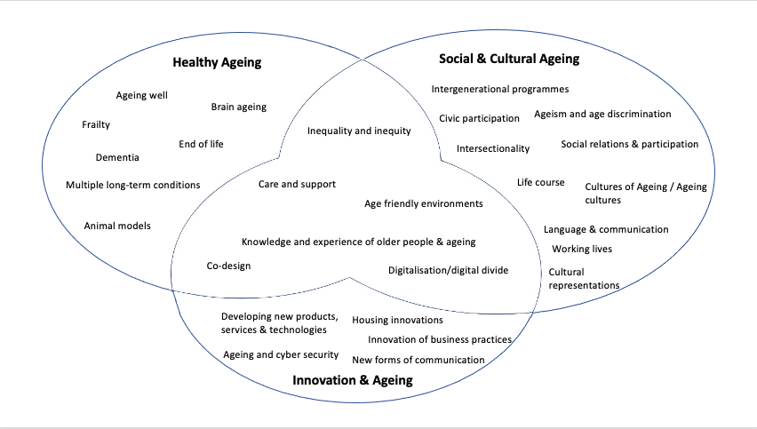

Slide 11
Part 1: Contrasting approaches to integrating the study of inequalities into research on ageing
Ageing: What’s inequality got to do with it?
    Panel A
    Shirley Jordan, Professor of French Studies
    Jacob Jewusiak, Senior Lecturer in Victorian Literature
    Bruce Davenport, Lecturer and Research Associate in Media, Culture, Heritage
    Panel B
    Matthew Prina, Professor of Ageing and Epidemiology
    David Lain, Senior Lecturer in Employment Studies
Notes:
BLANK SLIDE
To duplicate slide, select copy on tool bar and then duplicate on drop down menu.

Slide 12
Part 2: How can we work together to explore inequalities?
Ageing: What’s inequality got to do with it?
‘Inequalities and multi-disciplinarity: some provocative questions’, Heike Pichler, Reader in Sociolinguistics
Small-group discussions:
      In what ways, if at all, do inequalities shape your research?
      What types of ideas do you have for future research relating to ageing and inequalities?
      How might an interdisciplinary approach be of benefit to your research?
Notes:
BLANK SLIDE
To duplicate slide, select copy on tool bar and then duplicate on drop down menu.

Slide 13
Part 2: How can we work together to explore inequalities?
Ageing: What’s inequality got to do with it?
Small-group discussions:
      In what ways, if at all, do inequalities shape your research?
      What types of ideas do you have for future research relating to ageing and inequalities?
      How might an interdisciplinary approach be of benefit to your research plans?
Notes:
BLANK SLIDE
To duplicate slide, select copy on tool bar and then duplicate on drop down menu.

Slide 14
Next steps
Ageing: What’s inequality got to do with it?
Centre renewal, 2024-25
Exploring opportunities for external Centre funding
Evolving the Centre leadership and governance
Recruiting new members
Building links with key stakeholders
Notes:
BLANK SLIDE
To duplicate slide, select copy on tool bar and then duplicate on drop down menu.

